Slide 1
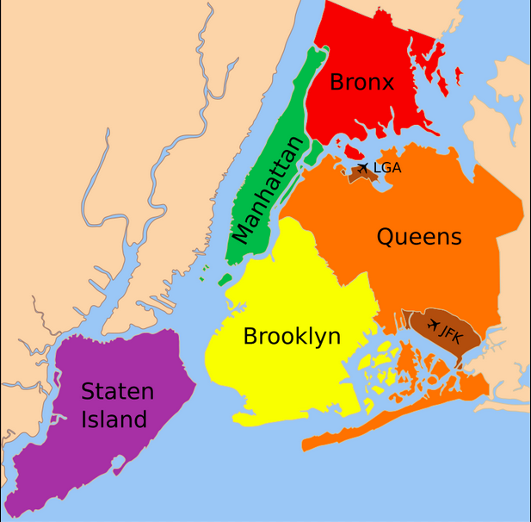
The Battle of Neighborhoods

Slide 2
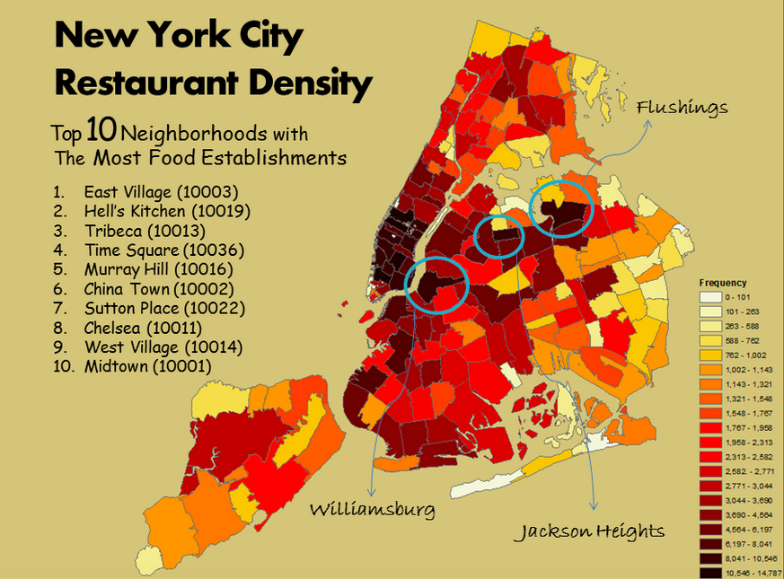
Introduction
New York City (NYC) review
Business Problem:
Choice of neighborhood
Low competition
High Demand
Choice of menu
Success Criteria
Best neighborhood

Slide 3
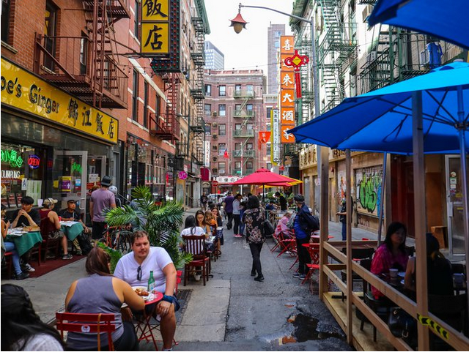
New York City
Most populous city in USA
Its diverse and financial capital
Multicultural with umpteen business opportunity
Proper market analysis is very important while trying to open any new venture in the city.

Slide 4
New York City business Environment
The City of New York is well known for its eclectic cuisine in various restaurants.
To survive in such competitive market it is very important to strategically plan.
Various factors need to be studied in order to decide on the Location such as:
Population
Demographics
Access to fresh produce
Locality etc.

Slide 5
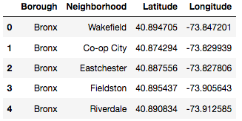
Data Description
New York has a total of 5 boroughs and 306 neighborhoods. In order to segment the neighborhoods and explore them, we will essentially need a dataset that contains the 5 boroughs and the neighborhoods that exist in each borough as well as the latitude and longitude coordinates of each neighborhood.

Slide 6
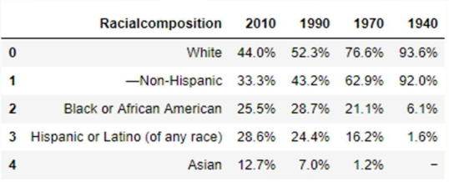
Data Description
New York Population, City Demographics and cuisines can be obtained from Wiki.

Slide 7
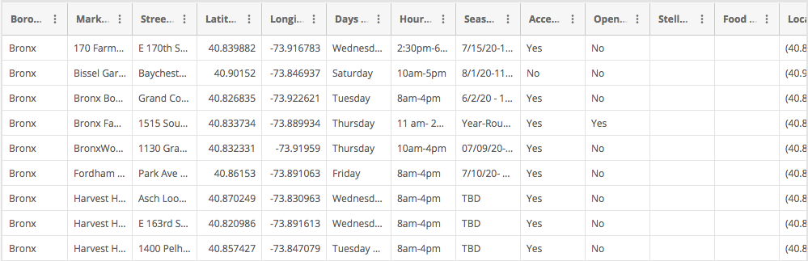
Data Description
DOHMH Farmers Markets and Food Boxes dataset can be obtained from:
https://data.cityofnewyork.us/dataset/DOHMH-Farmers-Markets-and-Food-Boxes/8vwk-6iz2

Slide 8
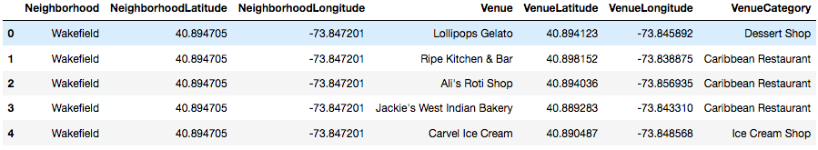
Data Description
New York city geographical coordinates data will be utilized as input for the Foursquare API, that will be leveraged to provision venues information for each neighborhood. We will use the Foursquare API to explore neighborhoods in New York City.

Slide 9
Approach
New York has totally 5 boroughs 306 neighborhoods
the first part in clustering of Manhattan and Brooklyn and second clustering is Bronx, Queens and Staten Island.
Only restaurant data is filtered from foursquare API
Exploratory data analysis is done on the resulting data set.

Slide 10
methodology
Load data in JSON format
Transform the data into nested python dictionaries
Dataframe contains the geographical coordinates of NYC neighborhoods
Restaurant data is obtained from foursquare API
Geopy and Folium libraries are used to create NYC neighborhood data

Slide 11
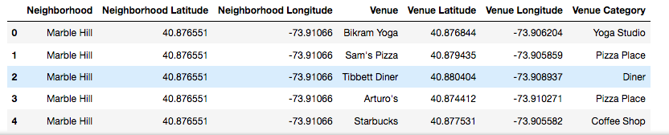
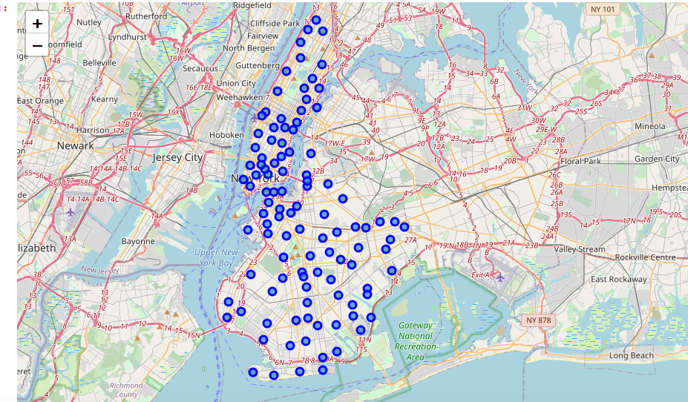
Part 1 – Brooklyn and Manhattan
Venues data
Venues Visualizations

Slide 12
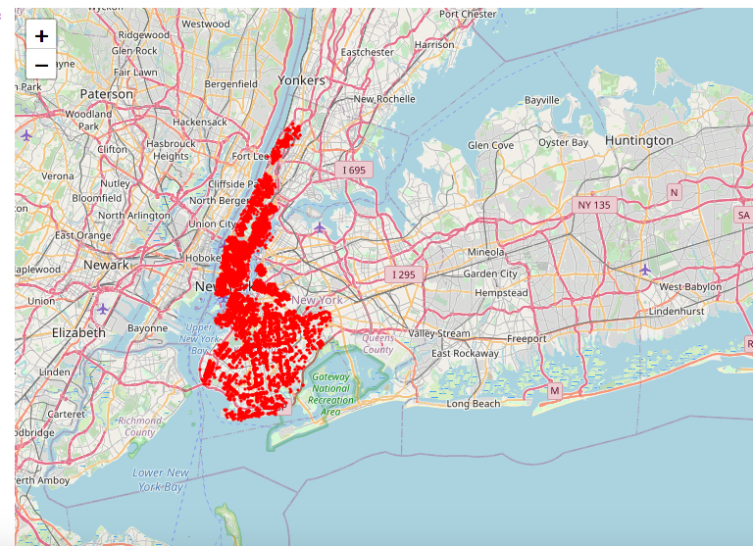
Part 1 – Brooklyn and Manhattan
Venue Visualization

Slide 13
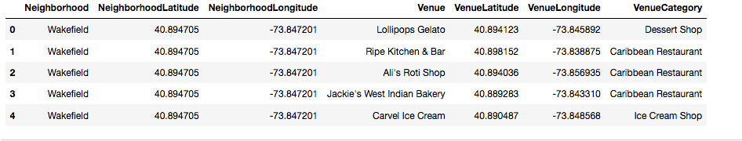
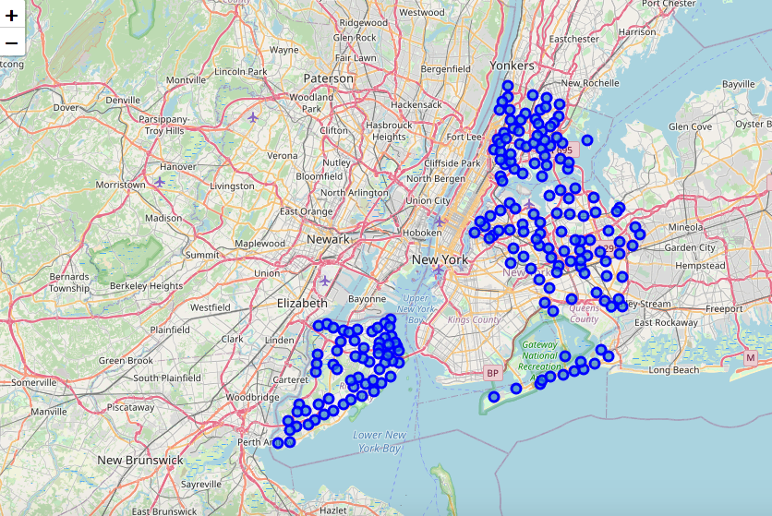
Part 2 – Bronx, Queens and Staten Island
Venues data
Venues Visualizations

Slide 14
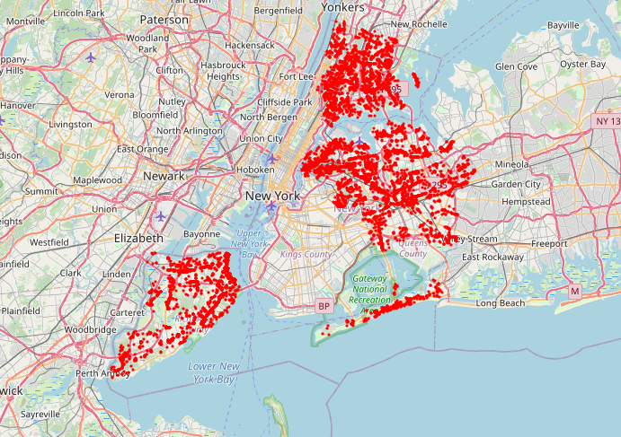
Part 2 – Bronx, Queens and Staten Island
Venue Visualization

Slide 15
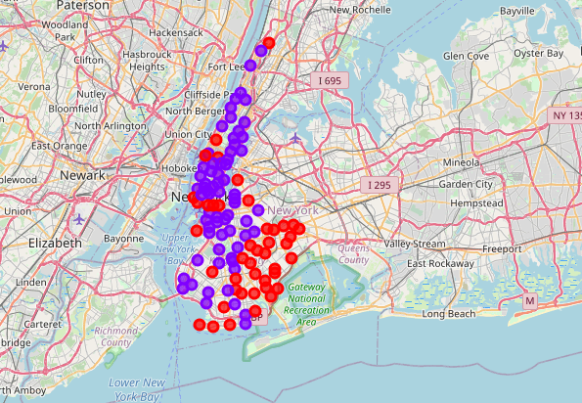
Result Part 1 – Brooklyn and Manhattan
Segmenting and clustering neighborhoods
Cluster 0 - The Total and Total Sum of cluster0 has smallest value. It shows that the market is not saturated.
Cluster 1 - The Total and Total Sum of cluster1 has highest value. It shows that the market is saturated.

Slide 16
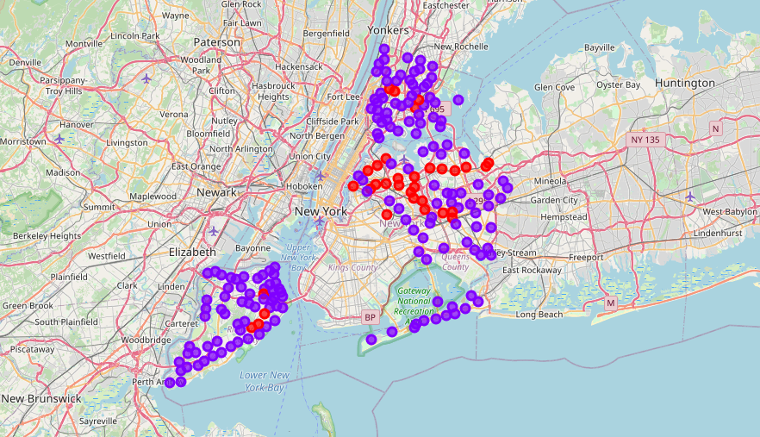
Result Part 2 – Bronx, Queens and Staten Island
Segmenting and clustering neighborhoods
Cluster 0 - The Total and Total Sum of cluster0 has highest value. It shows that the market is saturated.
Cluster 1 - The Total and Total Sum of cluster1 has smallest value. It shows that the market is not saturated

Slide 17
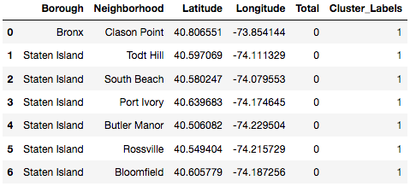
Result Part 2 – Bronx, Queens and Staten Island
The untapped neighborhoods are:

Slide 18
Discussion
There is scope to increase farmers market in the Bronx, Queens and Staten Island.
There is scope to explore cuisines in Bronx, Queens and Staten Island.
Manhattan and Brooklyn people like eclectic cuisine styles.

Slide 19
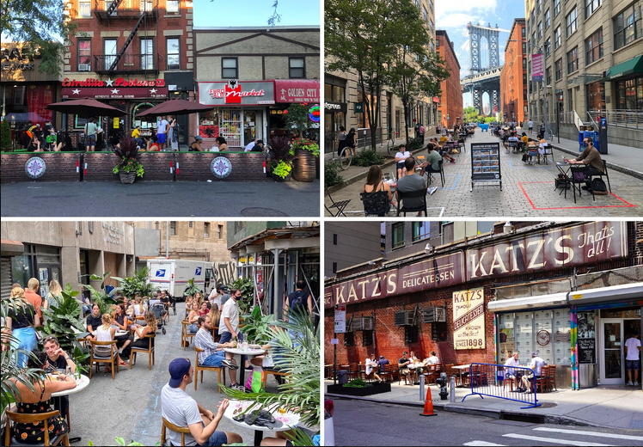
conclusion
From the limited data exploration, it can be concluded that there is huge demand of restaurants in NYC area.
Brooklyn and Manhattan have high number of restaurants and are of various cuisines. Hence the market is extremely competitive.
Bronx, Queens and Staten Island has scope of exploration.

